Slide 1
Object Oriented Programming
Created by JL

Slide 2
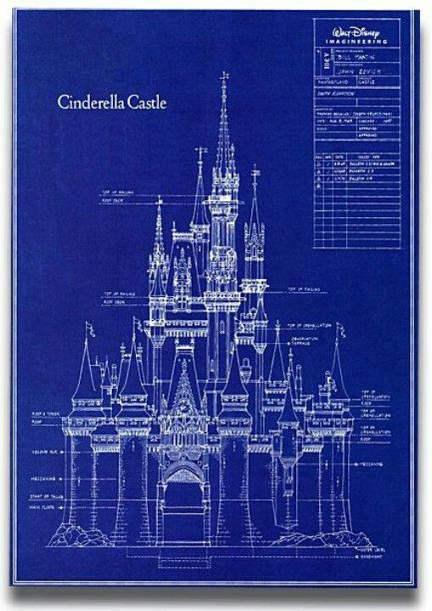
Class

Slide 3

Object (Instantiated Class)
Keyword = “new”
Castle disneyC = new Castle();

Slide 4



No castle yet

Slide 5

No access to the castle yet

Slide 6



Setter
.setGold()
.setMagnaCarta()
.setPrincess()

Slide 7
Setter
.getGold()
.getMagnaCarta()
.getPrincess()
Getter

Slide 8

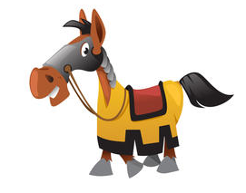


Setter
Method
.callTheCalvary()
.bringHorse()
.bringShield()
.bringMoreWeapon()
Getter

Slide 9
Setter
Method
Getter

Slide 10

Encapsulation
+
Public
Methods
-
Private
Variables

Slide 11
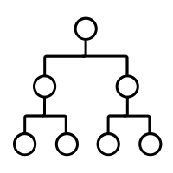
Inheritance
Vehicle → Car, Train, Ship
Knife → Swiss knife, kitchen knife,
butcher knife, switch blade,
butterfly knife

Slide 12
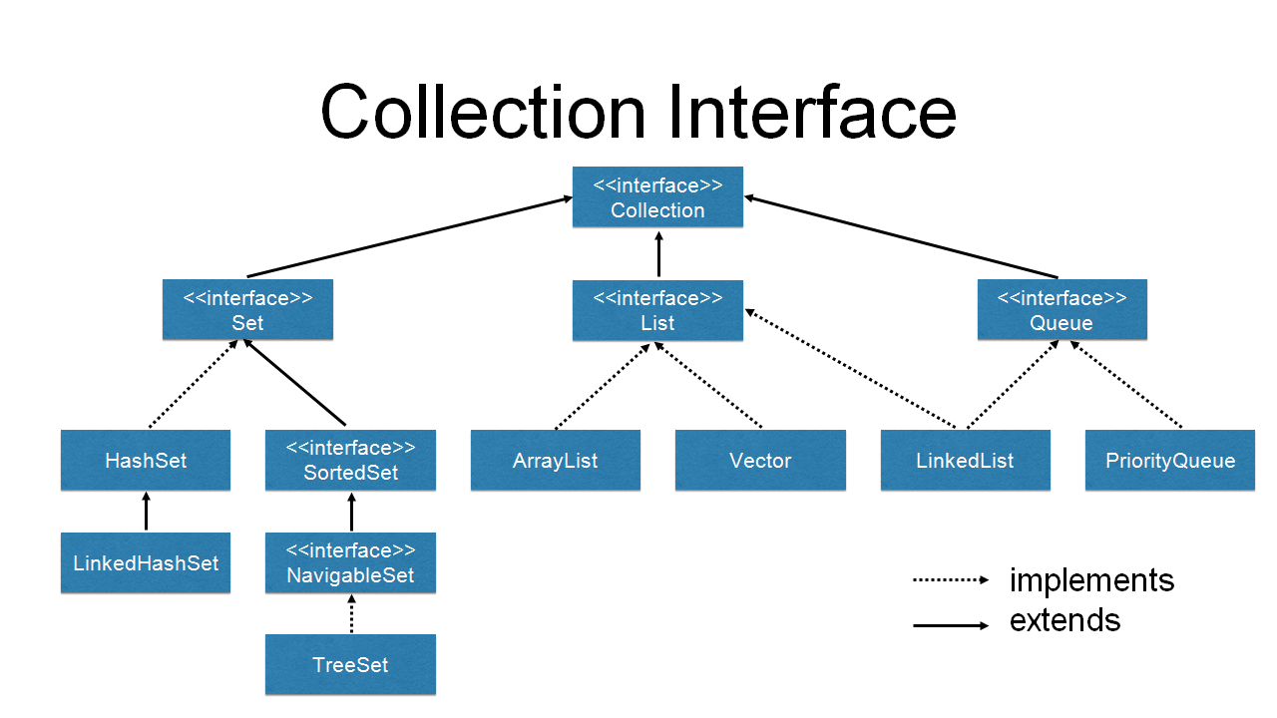
Inheritance

Slide 13
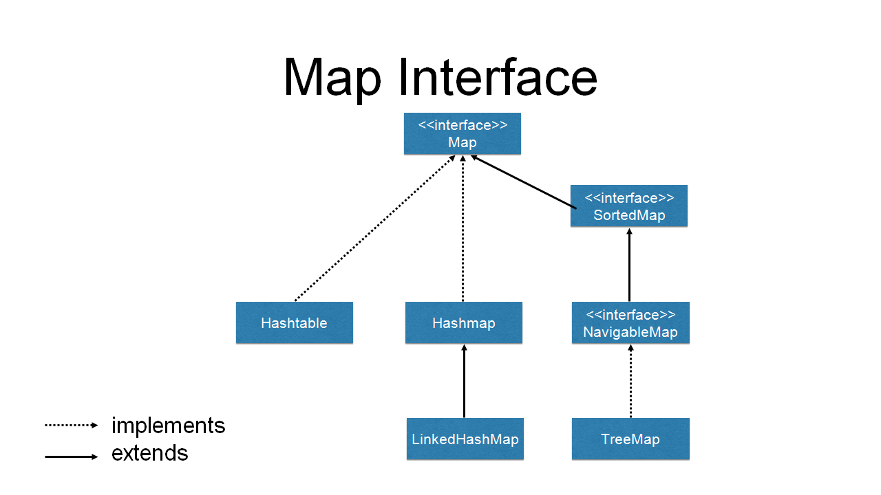
Inheritance

Slide 14
Composition
Vehicle has a:
Engine
Gas
Mileage
Windows
Doors
Windshield Wipers
Hood
Trunk
Note: use zoom in function as discussed. Pan out on car, zoom in on engine, etc

Slide 15
Abstract Class
Keyword = “extends”

Slide 16
Interface
Keyword = “implements”

